Slide 1
Experiential Learning Project Title: Chess Engine with C
Name : Radhey Sharma
Reg No. : 219311078

Slide 2
The aim is to make a program that enables its user to play chess against a basic chess AI or another player using c language.
Step 1 – Code an 8x8 board.
Step 2 – Code chess pieces.
Step 3 – Assign starting positions to the chess pieces.
Step 4 – Code movement and capture logic for different pieces.
Step 5 – Code in alternate turn logic and assign the first move to white.
Step 6 – Code in check/checkmate logic.
Step 7 – Code in draw logic.
Step 8 – Code a random move generator.

Slide 3
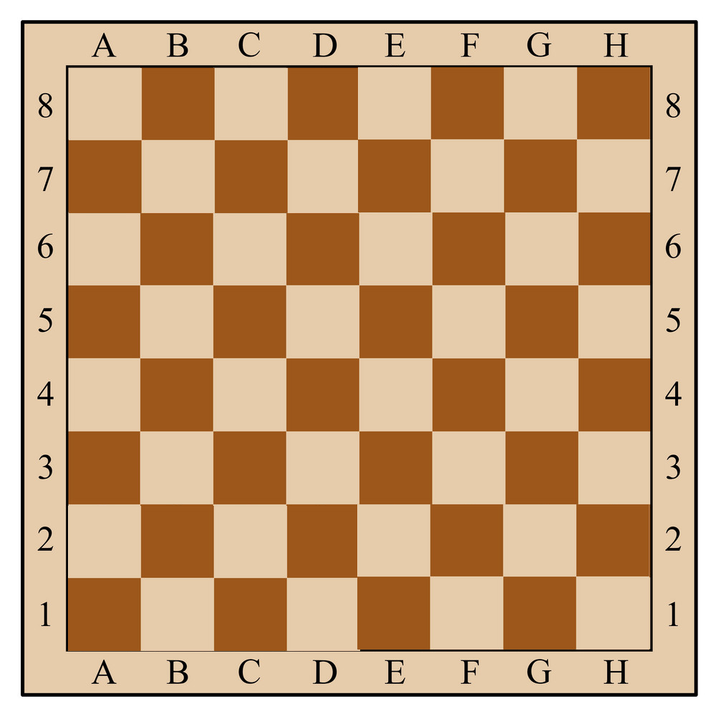
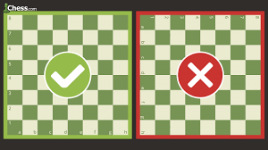
Step 1 – Code an 8x8 board

Slide 4

Step 2 – Code chess pieces

Slide 5
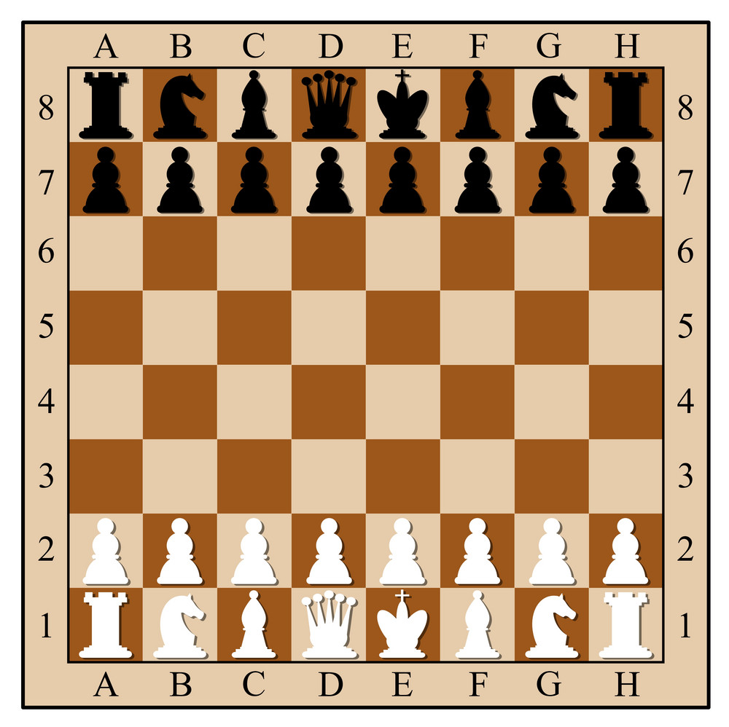
Step 3 – Assign starting positions to the chess pieces.

Slide 6
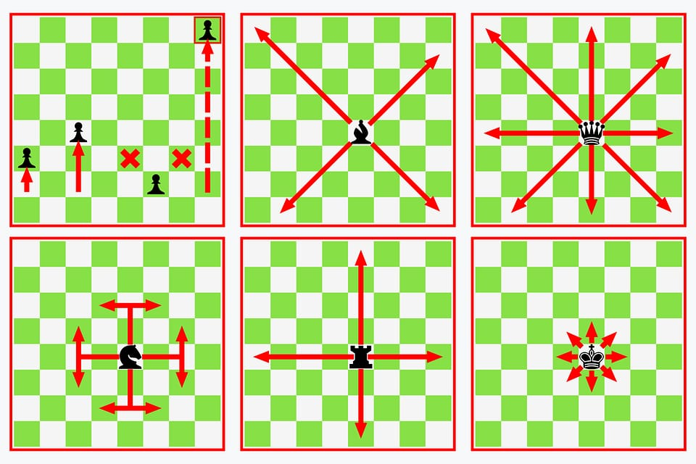
Step 4 – Code movement and capture logic for different pieces.

Slide 7
Step 5 – Code in alternate turn logic and assign the first move to white.
Second
First

Slide 8
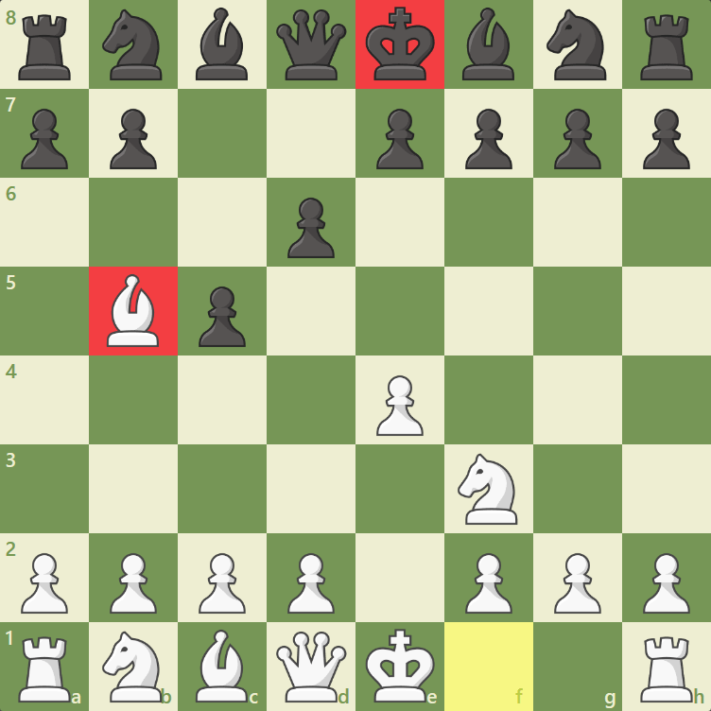
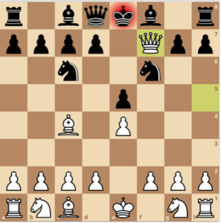
Step 6 – Code in check/checkmate logic.
Check Checkmate

Slide 9
Step 7 & 8 – Code in draw logic and code a random move generator.
A Stalemate is a type of draw that occurs in a game when one of the players isn’t in Check but also cannot make any legal move.
When both players agree to Draw – this type of Draw is called a Mutual Agreement.
A Threefold Repetition draw is declared when a player has made the same moves or is about to make the same move, three times in a row.
If both players haven’t captured any of the other player’s pieces or moved their pawns in fifty moves – a Fifty-Move Draw is declared.
An insufficient material draw is declared if both sides have any one of the following, and there are no pawns on the board:
A lone king
a king and bishop
a king and knight

